Slide 1
Team106online
Sprint 2

Slide 2
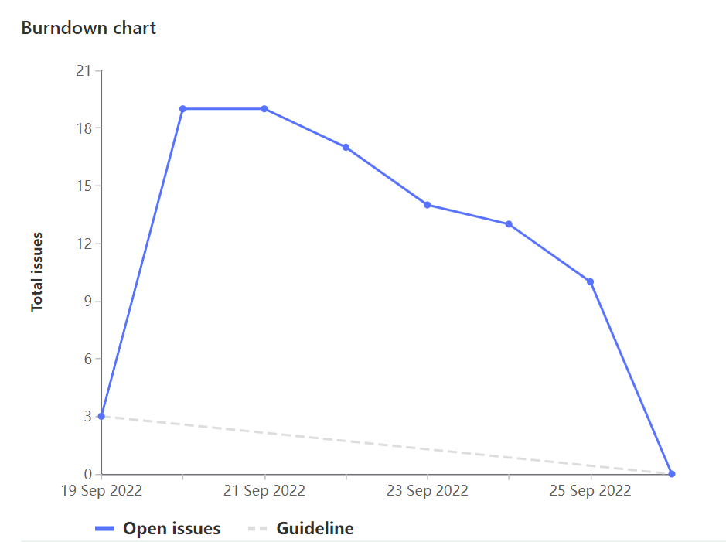
Sprint Progress

Slide 3
What Went Well
What To be Done Differently
Initial planning and breakdown of work
Technical design to allow for independent work, unblocking
Assign tasks sooner
Git branching strategy and merge request process still needs touching up

Slide 4
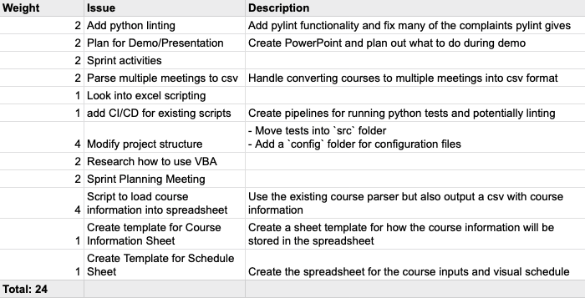
Team Member: Samuel Guilbeault
Work Highlights
Overhaul of file structure to take a module-based approach
Updating parser to produce a CSV in the correct format for the spreadsheet

Slide 5
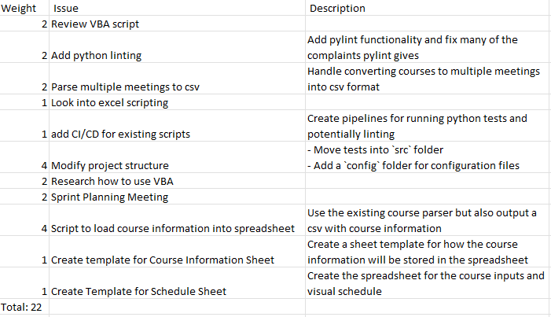
Team Member: Hyrum Nantais
Work Highlights
Creating CSV format for course information in html parser
Restructuring and reformatting project
Adding CI pipelines

Slide 6
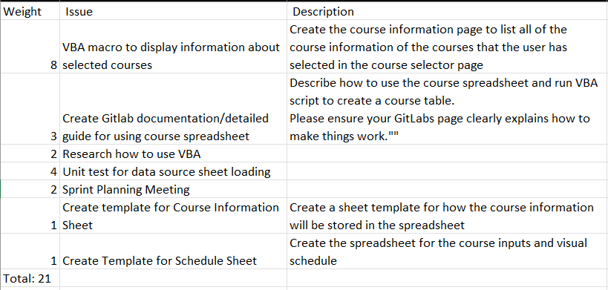
Team Member: Rehan Nagoor
Work Highlight:
Created the course information sheet. Allows users to see the information of their selected courses.
Created the documentation in Gitlab and excel.
Performed Unit testing.

Slide 7
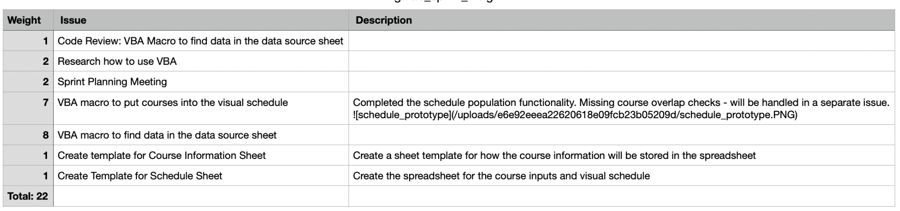
Team Member: Muhammad Salmaan
Work Highlights
This week my weight for the total work done was 22 weights.
My highlight : worked on the course scheduler on VBA and helped with the visual schedule layout as well as helping program it.
Had team meetings and reviews this week and pair programming for programming populate the course schedule.

Slide 8
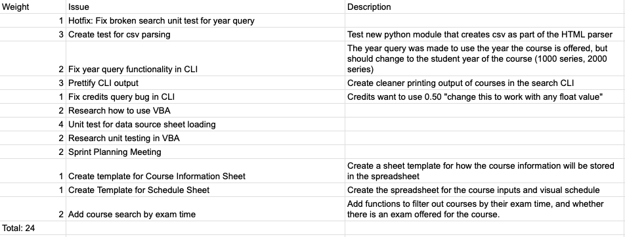
Team Member: Parker Carnegie
Work Highlights
Updated output of the CLI
Fixed bugs in CLI and HTML parser
Researched VBA and unit testing (Rubberduck)
Created unit tests for VBA functions

Slide 9
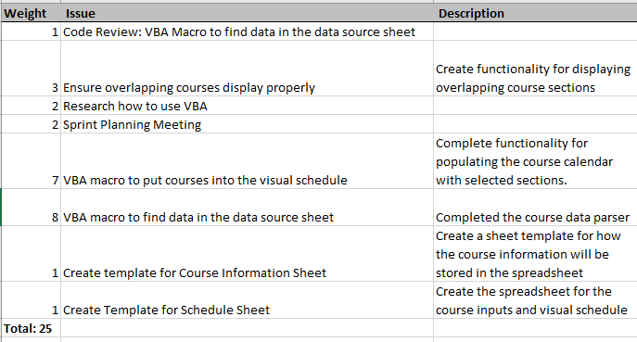
Team Member: Ivan Odiel Magtangob
Work Highlights
Team meetings
Working on VBA script for finding + parsing course data
Working on VBA script for populating course schedule
VBA research + code review

Slide 10
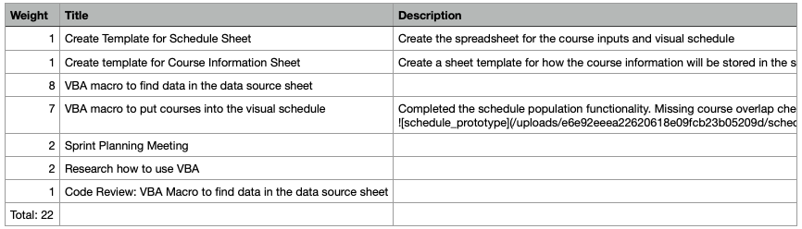
Team Member: Alif Merchant
Work Highlights
Researched VBA
Setup excel file and project modules
Worked on parsing the courses from the courses sheet.

Slide 11
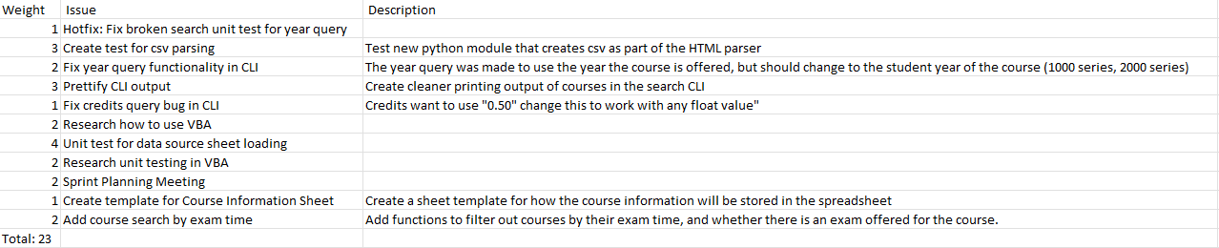
Team Member: Caleb Beere
Work Highlights:
Sprint planning meetings
Reformatting search CLI output for increased readability
Add a search parameter for querying courses based on their exam date
Refactoring the year query search parameter to reflect course level ( 1000, 4000, etc. )

Slide 12

Demo time!

